Slide 1

PRESS RELEASE
GHANA PRODUCER PRICE INDEX AND INFLATION
FEBRUARY 2023
22ND MARCH 2023

Slide 2

In this release, we present:
Definition and Measurement of the Producer Price Index (PPI)
Producer Price Index and Producer Inflation for February 2023
Disaggregation of the 2023 Producer Inflation
Highlights of February 2023 Producer Inflation

Slide 3
Definition and Measurement of PPI and Inflation (1/2)
The Producer Price Index (PPI) measures the average change over time in the selling prices of goods and services as received by domestic producers.
Price collected for the computation of PPI are known as factory gate prices, which are the prices firms assign to their products.
These prices exclude sales and excise taxes, government subsidies other costs incurred by other intermediaries and consumers
The rate of Producer Inflation is the relative change in PPI between periods

Slide 4
Definition and Measurement of PPI and Inflation (2/2)
PPI computation is based on a fixed basket of products.
Firms are the primary source of data
Firms are selected based on the Integrated Business Establishment Survey
Variables for the computation of PPI are weights, prices, quantities and products.
Two reference periods for the computation of PPI are the weight reference (industry and product shares) and the index reference for price comparison.
The computation is done from a dual time perspective, monthly and annually

Slide 5
Reference Periods - PPI and Inflation
Weight Reference-2019
  Weight reference at the industry level is based on 2019 Gross Value Output (GVO)
  Selection of firms is based on the Integrated Business Establishment Survey (II)
  Index Reference (Price Comparison)– March 2020 to February 2021 =100

Slide 6
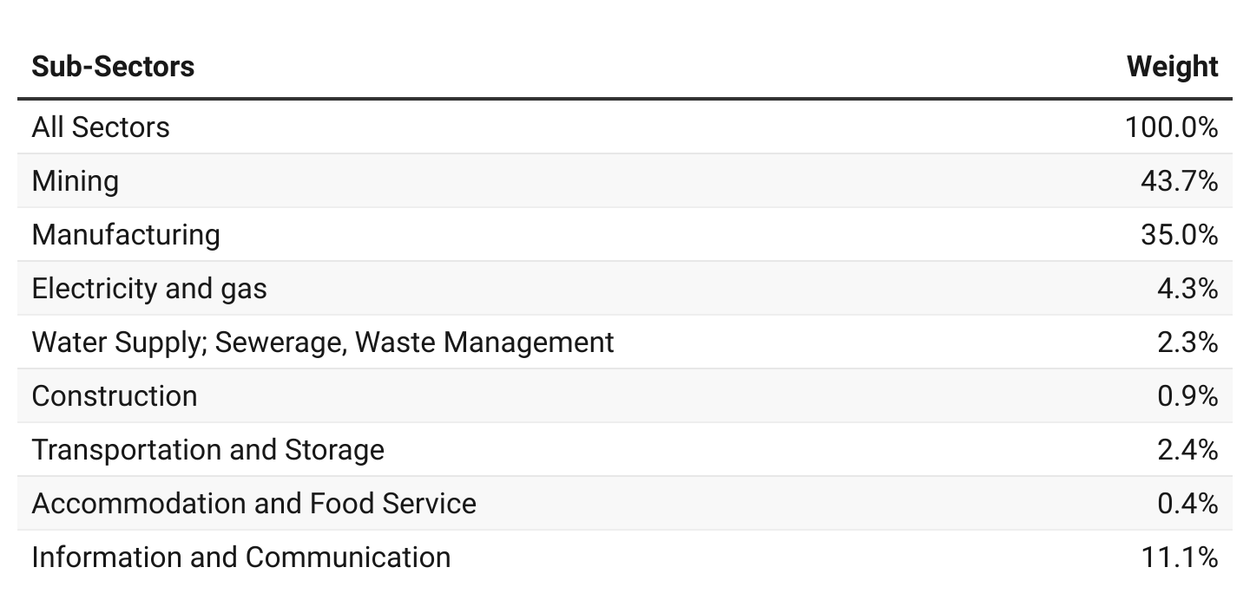
PPI Weights

Slide 7
Producer Price Index and Producer Inflation for February 2023
Year-on-year inflation rate at factory gate prices for all goods and services was 50.8 % in February 2023.
The monthly producer inflation rate was 7.0%.
Month | PPI (03/2020-02/2021 =100) | Inflation
 |  | Monthly | Yearly
Dec. 2022 | 178.1 | -13.2 | 52.2
Jan. 2023 | 180.0 | 1.1 | 52.5
Feb. 2023 | p192.6 | p7.0 | p50.8
p = provisional
Notes:
The difference between year producer inflation for September 2021 and September 2022 was 5.9 percentage points and the monthly difference between August 2022 and September 2022 was also 5.8 percentage points

Slide 8
Disaggregation of the 2023 Producer Inflation by Sectors

Slide 9
Disaggregation of the 2023 Producer Inflation by Sub-Sectors

Slide 10
Change in Sub-Sector Producer Inflation Jan. Vs. Feb. 2023

Slide 11
Manufacturing Sub-Sector

Slide 12
Mining and Quarrying Sub-sector

Slide 13
Construction Sub-Sector

Slide 14
Services Sub-sector

Slide 15
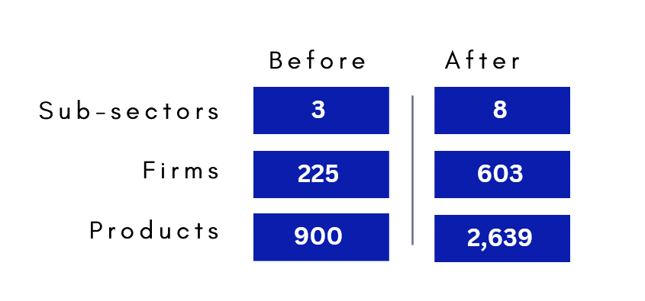
Highlights (1/3)
The new PPI is referenced March 2020 – February 2021
Weight reference is 2019

Slide 16
Highlights (2/3)
55.7%
Manufacturing
61.2 %
Mining and quarrying
57.9 %
Industry
57.4%
Electricity and gas
32.5%
Water supply, sewerage and waste management
52.6%
January 2023 yearly Producer Inflation
50.8 %
February 2023 yearly Producer Inflation
67.6 %
Transport and storage
21.1 %
Constructions
13.4 %
Service
66.5 %
Accomodation and food
4.5%
Information and communication

Slide 17
Highlights (2/3)
5.0%
Manufacturing
8.6 %
Mining and quarrying
7.7 %
Industry
21.5%
Electricity and gas
5.8 %
Water supply, sewerage and waste management
7.0 %
February 2023 monthly Producer Inflation
1.1 %
January 2023 monthly producer inflation
7.2 %
Transport and storage
3.4%
Service
1.7 %
Constructions
7.9 %
Accomodation and food
2.5 %
Information and communication

Slide 18
Thank You
For enquiries, please contact
Mr. Anthony Krakah
Head, Industrial Statistics, Ghana Statistical Service
Email: anthony.krakah@statsghana.gov.gh

